Slide 1
XSAM course
Stock assessment - data
Sondre Aanes
IMR, Bergen
15 - 17/1-2017

Slide 2





From data to management advice a «bottom up» example description
Reference fleet
Surveillance fleet
+Others
Data/sampling
programmes:
Coastguard
Scientific surveys
Fishery induced mortality: Catch at age, bycatch, discards,…
Stock status: Index of abundance at age,…
Input:
Model:
Assessment model
Stock status + HCR→
Management advice
SSB,…,+HCR → Quota advice

Slide 3
Data
Stock assessment uses data:
Catch@age
Abundance indices@age
Weight@age
Proportion mature@age
Here we focus on catch at age and abundance at age from scientific surveys and goes beyond traditional use of data (i.e. points estimates)

Slide 4
Estimation (input data)
Two main approaches
Design based
Model based
All depend on a well defined survey sampling design to enable correct quantification of sampling errors!
Better to be vaguely right than precisely wrong!

Slide 5
Catch data
Statistical population = e.g. the total catch of a species in a year
Total catch is the sum of all catch operations across gear, time and space

Slide 6
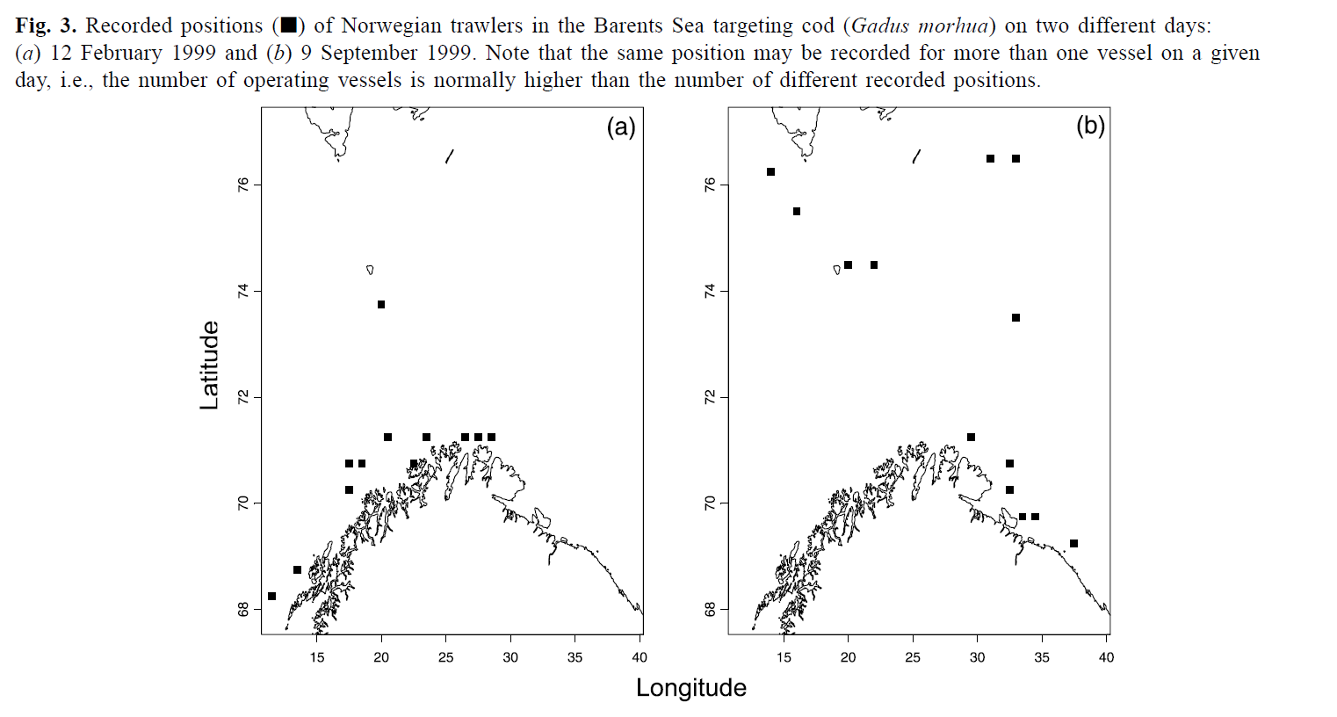
Commercial catches example spatial distribution
From Salthaug and Aanes, 2003

Slide 7
Nested sampling
Example reference fleet:
Sample a boat
Sample a trip within the boat
Sample a catch within trip
Sample a fish for age and or length within the catch
→ data is clustered

Slide 8
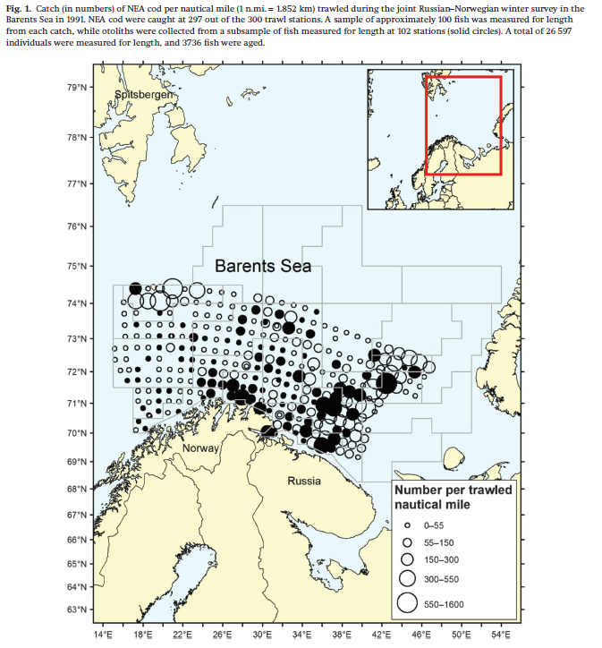
Scientific surveys
From Aanes and Vølstad, 2015

Slide 9
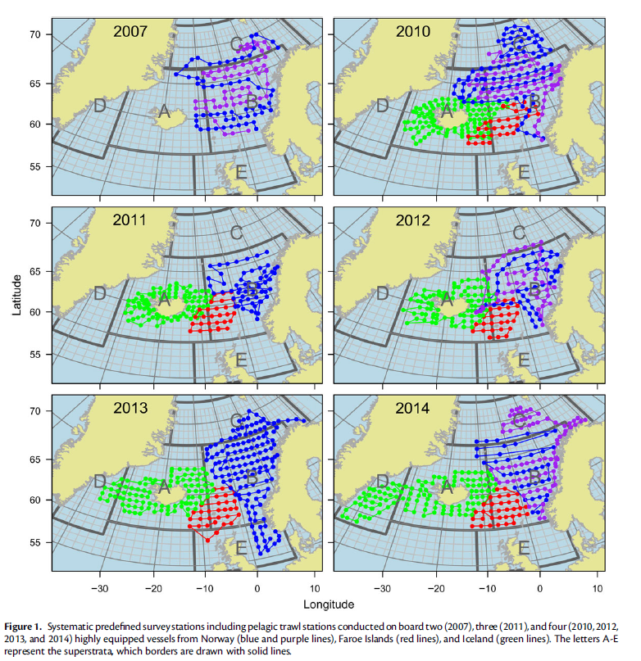
Scientific surveys
From Nøttestad et al., 2016

Slide 10
Scientific surveys
Statistical population = e.g. biological population (a fish stock)
Sampling:
Catch (trawl surveys) or transect (acoustic surveys)
Sample a fish for age and or length within the catch
→ data is clustered (but less so than commercial catches)

Slide 11
→Multistage cluster sampling
Common to all monitoring programs
Hierarchical sampling and complex designs
It is NOT: simple random sampling. I.e. cannot easily enter into a database and pool data together and assume simple random sampling: result in severe bias and overestimation of precision!
Effective sample size is low
Complexity of sampling designs and thus estimators is reckognised by ICES: e.g. WGCATCH
Estimation is not trivial
But generally ‘OK’ if data is analysed according to the design

Slide 12
Uncertainty is determined by
Sampling design
Estimator
Sampling effort
Structure of target population (spatial, temporal, size, etc…)
Efficient estimators should reflect the actual design!

Slide 13
Be aware
Other sources of error in input data:
Nonresponse
Coverage
Measurement errors
Aging errors
…
…
Will not be a focus here, but see e.g. Hirst et al. 2012 for an example for aging error can be handled.

Slide 14
Example of estimation

Slide 15


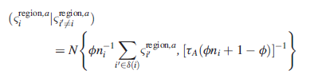
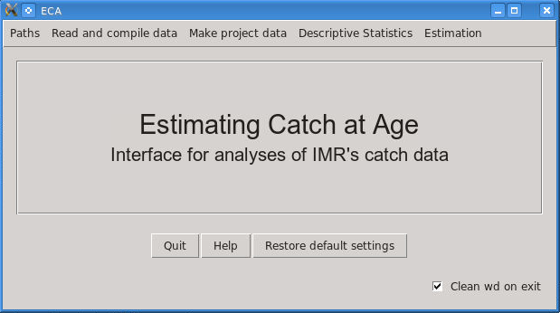
ECA; estimating catch@age
A model to estimate catch-at-age of fish
uses data on age, length and age-given-length.
The method allows for uncertainty in ageing
and stock separation coastal cod - NEA cod based on otolith type and uncertainty in classification of type.
Documented by Hirst et al. 2004, 2005 and 2012.
Unique
An R-library with a graphical user interface
The model is implemented in C with an R interface.
Currently extract and filters biological data from IMRs data base
In routine use at IMR for several species
Current work on implementation in StoX

Slide 16
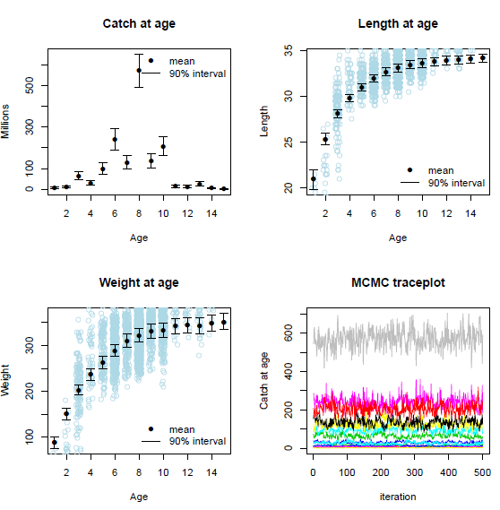
ECA; example of output

Slide 17
Catch at age – analyzed by ECA
Summary of catch at age:
Estimates are extracted from: SILD'G032011.fitFINALAGE.2011_allgears_totalarea_season1234
based on fitted object: SILD'G032011.fitFINALAGE
Catch at age is summed over:
years: 2011
areas: 0 3 4 5 6 7 8 9 12 27 28 30 34 36 37 39 42
gears: 35 37
seasons: 1 2 3 4
total reported catch: 572238.42 tons
Catch at age (millions)
age mean sd 5% 95%
1 3.94 2.7 0.57 8.98
2 292.44 56.76 208.34 390.1
3 101.34 22.42 67.53 139.28
4 101.03 22.77 67.16 139.16
5 200.04 36.57 148.87 265.48
6 109.57 23.6 76.45 150.69
7 428.8 59.76 336.63 523.04
8 287.38 46.17 218.15 369.69
9 328.01 47.39 254.15 407.14
10 37.76 10.25 23.63 55.68
11 42.97 11.66 25.71 63.53
12 52.3 14.18 32.35 78.43
13 22.15 7.05 12.05 34.02
14 3.28 2.39 0.8 8.23
15+ 8.64 2.91 4.36 13.15
Mean age in catch
mean sd 5% 95%
6.52 0.16 6.24 6.76
Length at age (cm)
age mean sd 5% 95%
1 23.24 0.51 22.26 23.91
2 26.66 0.11 26.48 26.85
3 28.44 0.13 28.23 28.63
4 29.61 0.12 29.42 29.81
5 30.67 0.11 30.47 30.85
6 31.76 0.12 31.57 31.96
7 32.5 0.11 32.33 32.69
8 33.2 0.12 33.01 33.4
9 33.69 0.12 33.49 33.9
10 34.21 0.14 34 34.44
11 34.53 0.13 34.32 34.75
12 35 0.14 34.79 35.23
13 35.28 0.15 35.04 35.52
14 35.51 0.18 35.23 35.79
15+ 36.16 0.17 35.87 36.42
Mean length in catch
mean sd 5% 95%
31.55 0.2 31.24 31.86

Slide 18


What is causing the variability for catch at age?
The hetereogenity in the total catch
The sampling design and effort
The number of boats (most important)
The number of trips/hauls (less important)
Types of samples: age vs length (important)
Number of fish within within hauls (of minor importance)

Slide 19
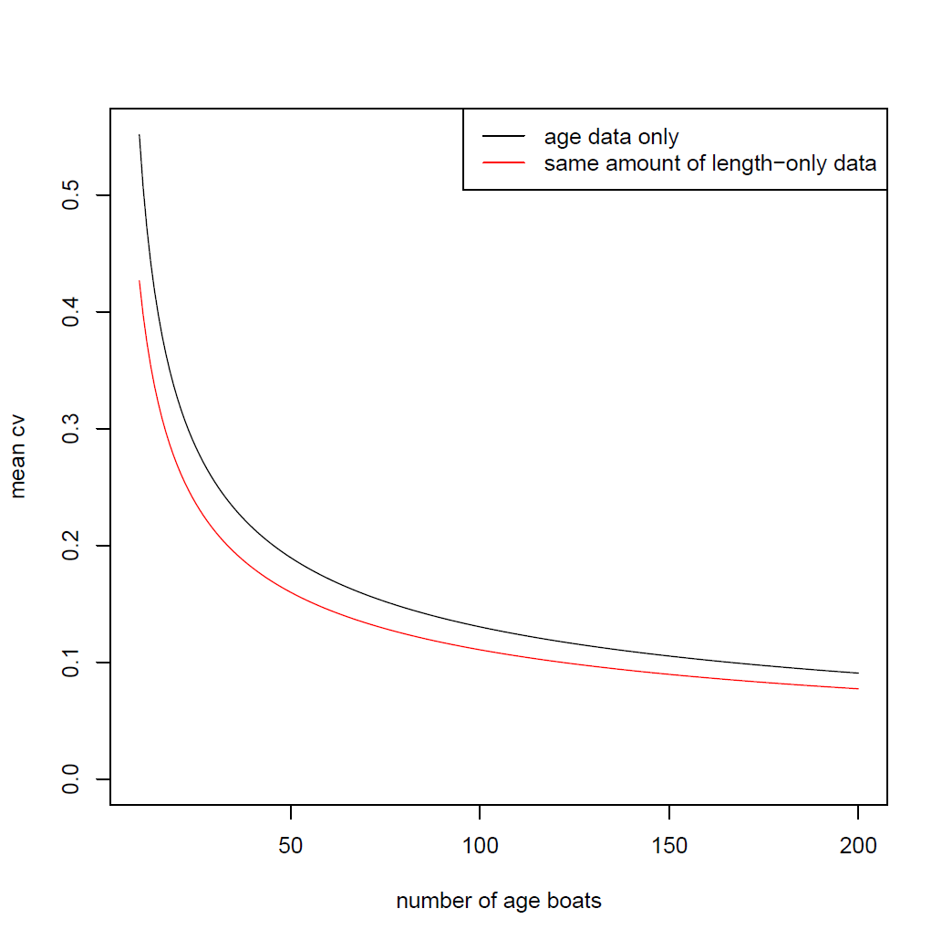
Links to sampling and cost:
Work in progress by Hirst et al.
Critical assumptions!:
-Samples sufficiently spread over the fishery (gears, time,…)
-Simple random sample of boats within each stratum
~80 boats with age samples
~60 boats with age samples +~60 boats with length samples

Slide 20
Abundance at age – analyzed by StoX
age Ab.Sum.5% Ab.Sum.50% Ab.Sum.95% Ab.Sum.mean Ab.Sum.sd Ab.Sum.cv
10 2 52.160147 347.0553621 904.544405 389.9394738 280.6697335 0.7197777
11 3 152.011296 514.7150219 1169.385972 564.5008948 310.1077271 0.5493485
12 4 794.358091 1544.5250216 2541.857585 1582.2648904 544.2919286 0.3439955
13 5 781.331799 1550.4770007 2306.874240 1543.1705044 463.0736680 0.3000794
14 6 1773.796147 2615.3810363 3576.908096 2647.5524621 568.8598588 0.2148625
15 7 454.850516 1036.0109382 1825.221045 1077.6823452 430.7556752 0.3997056
16 8 442.919248 648.2477996 960.265696 673.7364196 160.6433512 0.2384365
17 9 1223.274273 1835.0998030 2676.577408 1866.0608646 435.2161505 0.2332272
2 10 1827.372380 3124.7919797 4479.151567 3169.2233173 785.8108616 0.2479506
3 11 3095.527829 4292.1030022 5710.113343 4332.9688162 811.6773110 0.1873259
4 12 1022.894372 1508.8205362 2073.369818 1517.8911855 329.8388911 0.2173007
5 13 634.243391 1083.3658419 1593.622771 1089.8542724 291.2310299 0.2672202
6 14 92.300166 250.2485456 402.903438 242.6729576 101.3066488 0.4174616
7 15 58.490270 196.9931521 347.451614 189.8926687 95.3473211 0.5021116
8 16 3.927018 9.3065882 15.044865 9.4151348 3.4488750 0.3663118
9 18 0.000000 0.8512313 1.980744 0.7820387 0.7192306 0.9196867
1 <NA> 0.000000 2.0759831 6.478045 2.3078921 3.1072092 1.3463408

Slide 21
Having analyzed input data… Summarizing results – data quality

Slide 22
Data quality – herring example
Figure 1. Summary of estimates of Norwegian catch at age in 2008, abundance indices at age from the May survey (Fleet 5) in 2015, and Norwegian acoustic survey on spawning grounds (Fleet 1) in 2015 for NSS herring. Numbers at age (1. column) with 95% confidence intervals, relative standard error at age (2. column), correlation of abundance estimates by age (3. column), and correlation by distance in age (4. column). Estimates of catch at age are based on ECA, while estimates of abundance at age are based on StoX.

Slide 23
Data quality – cod example Norwegian catch at age
Estimates derived using ECA

Slide 24
Data quality – cod example Abundance indices from the Norwegian bottom trawl survey FLT15
Estimates derived using StoX

Slide 25
Questions
Are data iid?
Variance vs mean?
Implications for poor yearclasses?
Dependencies?
Implications for data weighting?

Slide 26
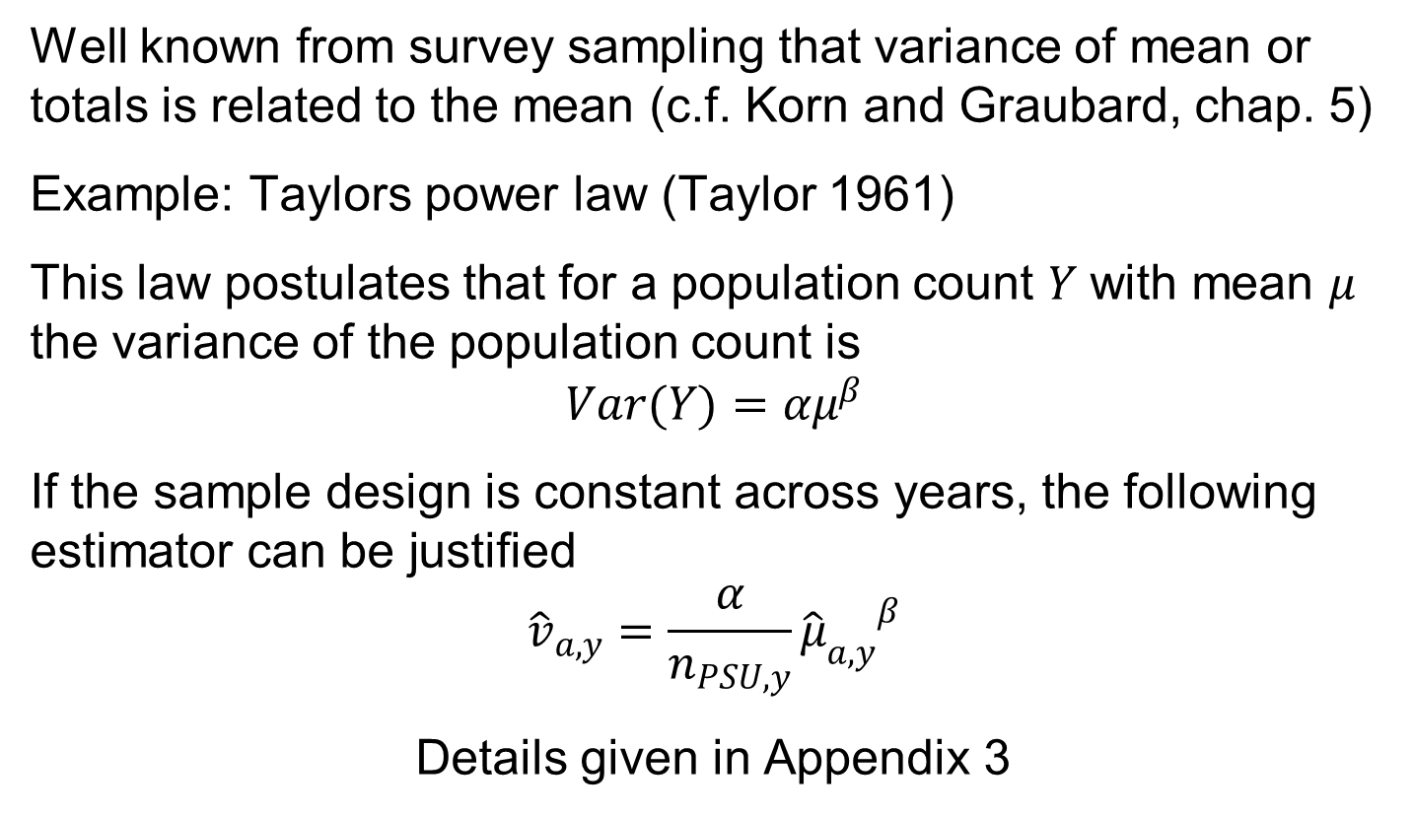
Variance-mean relationships
Well known from survey sampling that variance of mean or totals is related to the mean (c.f. Korn and Graubard, chap. 5)
Example: Taylors power law (Taylor 1961)
This law postulates that for a population count $Y$ with mean $μ$ the variance of the population count is
$$Var(Y)=αμ^{β}$$
If the sample design is constant across years, the following estimator can be justified
$${\hat{v}}_{a,y}=\frac{α}{n_{PSU,y}}{{\hat{μ}}_{a,y}}^{β}$$
Details given in Appendix 3

Slide 27
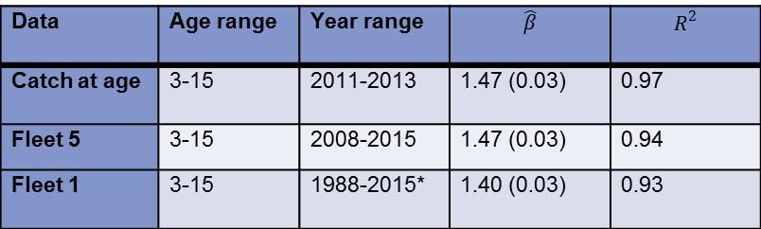
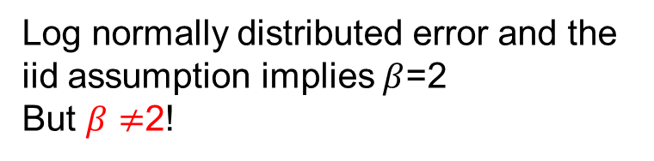
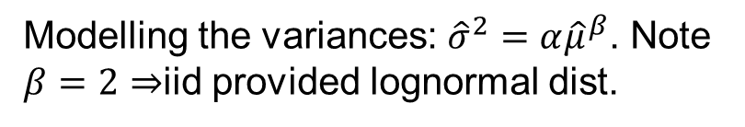
Mean – variance relationship; herring example
Modelling the variances: ${\hat{σ}}^{2}=α{\hat{μ}}^{β}$. Note $β=2⇒$iid provided lognormal dist.
Data | Age range | Year range | $$\hat{β}$$ | $$R^{2}$$
Catch at age | 3-15 | 2011-2013 | 1.47 (0.03) | 0.97
Fleet 5 | 3-15 | 2008-2015 | 1.47 (0.03) | 0.94
Fleet 1 | 3-15 | 1988-2015* | 1.40 (0.03) | 0.93
Figure A3.1. The Taylor variance function fitted to data (2008-2015) for the May survey (fleet 5) on sampling variances and estimates of abundance. On the logarithmic scale the R-squared is 0.94.
Log normally distributed error and the iid assumption implies $β$=2
But $β≠$2!

Slide 28
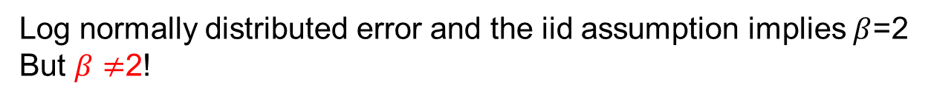
Mean – variance relationship; cod example
Modelling the variances: ${\hat{σ}}^{2}=α{\hat{μ}}^{β}$. Note $β=2⇒$iid provided lognormal dist.
Data | Age range | Year range | $$\hat{β}$$ | $$R^{2}$$
Norwegian Catch at age | 1-13 | 2001-2011 | 1.48 (0.03) | 0.94
Winter survey | 1-15 | 2012-2013 | 1.58 (0.03) | 0.97
Log normally distributed error and the iid assumption implies $β$=2
But $β≠$2!

Slide 29
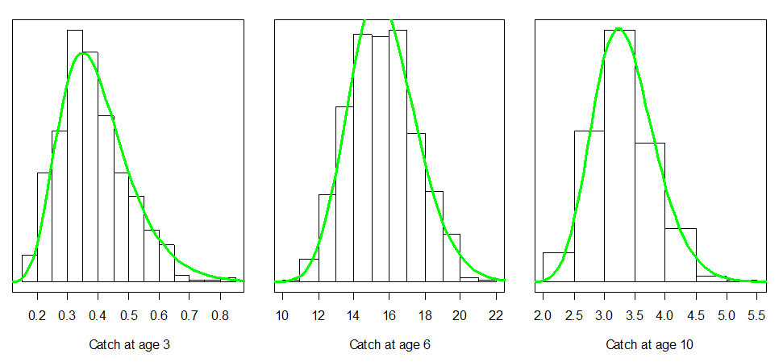
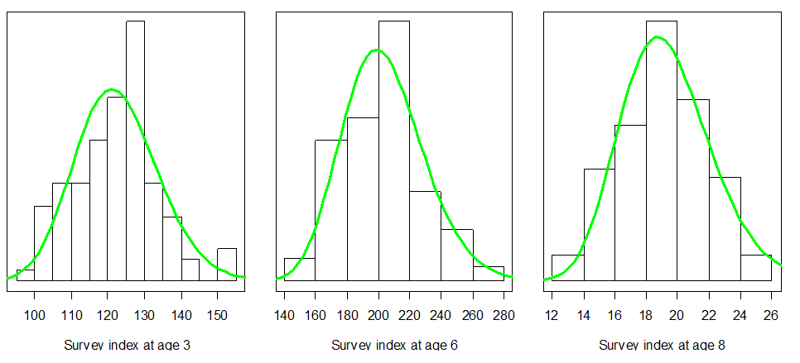
Distribution?
Most data can be adequately approximated by the log-normal distribution

Slide 30
Implications
Can model and predict the variances
BUT depend on sample design!!
Can justify a distributional family?
These features are in practice suggested to be utilized by XSAM

Slide 31
Summary – data
Input data are estimates
A result of complex sampling.
The quality of the input data depend on many factors
The uncertainty can be quantified provided clearly defined sampling frames and sampling designs
Knowledge about uncertainty is needed to evaluate and optimize sampling programmes

Slide 32
Summary – data
Error structures are complex and variable
These analysis is often in agreement with inspection of catch curves.
Error structures in input data should be reflected in any method using data in order to avoid bias in inference
Contains information on how respective data should be weghted
Contains information on the uncertainty from in integrated modelling (e.g. Integrated Population Modelling)
Can the complex error structures be captured by an assessment model based on point estimates?

Slide 33
Summary data
By spending time on analysing input data (point estimates and sampling errors) it can be ‘predicted’ what we can learn from the data concerning stock parameters
Should be done prior to throwing data at the model

